Slide 1
Hanover Inc. Managerial Report.
Akshay Appani
Trine University
12/14/2023

Slide 2
Background
The demand for Hanover products is steadily rising, and the company needs help meeting its production capacity.
The company manufactures fiber optic FA, fiber optic FB, and fiber optic FC.
There are currently two Hanover plants situated in Austin and Paris.
The present production capacity of these two plants is 600,000 units per year.
The corporation has chosen to maintain the operation of these two factories, with the flexibility to adjust their capacity up to 600,000 units.
The seven potential sites for developing the new production factory were Charleston, Mobile, Australia, India, Malaysia, South Africa, and Spain.
The customer regions of Hanover include Malaysia, China, France, Brazil, the US Northeast, the US Midwest, and the US West.
The determinants of the decision to create a new factory include duty rate, fixed cost, forecast, freight and warehousing costs per unit, price, and variable cost.

Slide 3
New Plant
Given the product demand projection data provided by the planning and forecasting department.
The graph indicates that the projected demand for product A across all regions will be 878,410 units during the next five years.
The projected demand for product B across all regions for the next five years is 717,650 units.
The projected demand for product C over five years is 1,073,410 units.
1200000
1073410
Forecast Demand for Five Years
1000000
878410
800000
717630
600000
400000
200000
0
A
B
C
Product

Slide 4
New Plant
Product A
Product B
Scatter charts are created to depict the relationship between variables and magazine sales, after eliminating unnecessary elements for predicting future magazine sales.
The scatter plots indicate that many anticipated indicators, like the year, return, and previous season's number of victories in the competition, do not exhibit a substantial correlation with magazine sales .
Although these factors are included in the initial regression model, it is crucial to thoroughly analyze the model's output to ascertain its ability to reliably predict magazine sales.
Upon examining the table above, it becomes apparent that US West is the primary purchaser of B items from Hanover.
The projected quantity of product B from the US West region is 295,230.
Next, the United States West region and France are the primary purchasers of product A.
The projected quantity of product B from the US Midwest region is 175,030.
The projected quantity of product B from the US Southeast region is 71130.

Slide 5
New Plant
Product C
The projected demand for product C from each location for five years is as follows:
Customer | Product | Forecasted Volume
China | C | 224750
US West | C | 182080
France | C | 165930
US Southeast | C | 155230
US Midwest | C | 133160
Malaysia | C | 127360
Brazil | C | 77070
US Northeast | C | 7830

Slide 6
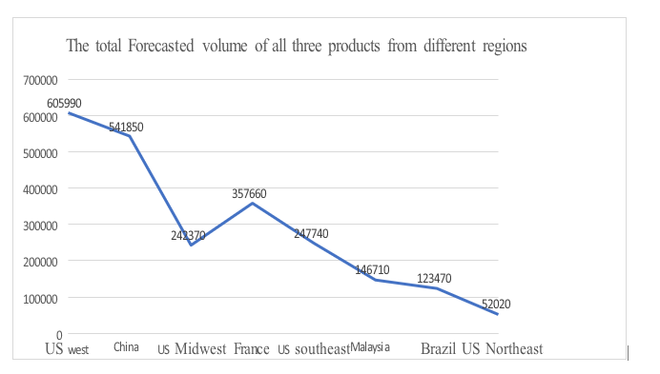
New plant
The user's text is a symbol. The projected volume from the US West area is 605,990 units, from China is 541,850 units, from the US Midwest is 242,370 units, from France is 357,660 units, from the US Southeast is 247,740 units, from Malaysia is 146,710 units, from Brazil is 123,470 units, and from the US Northeast is 52,020 units.
The user's text is a symbol. Hanover's three most prominent consumers are the US West, China, and the US Midwest.
By analyzing the forecast data, it is evident that there is a growing need for Hanover fiber optics goods.
The corporation must develop a new plant to fulfill the product's global demand

Slide 7
Location of the Plant
Selecting an appropriate plant location poses a challenging undertaking for Hanover due to the many considerations that impact the decision.
The key elements influencing selecting a manufacturing plant are the availability of raw materials, proximity to the client region, constant and variable costs, duty rates, availability of skilled labor, costs associated with freight and warehousing, political situations, and local rules and regulations.
For instance, if Hanover selects the United States as the location to set up a manufacturing facility, the firm will be subject to different import duties on its products for several countries. Specifically, the duty rates for Malaysia, China, France, Brazil, and the United States are 0.220, 0.300, 0.090, 0.120, and 0.042, respectively

Slide 8
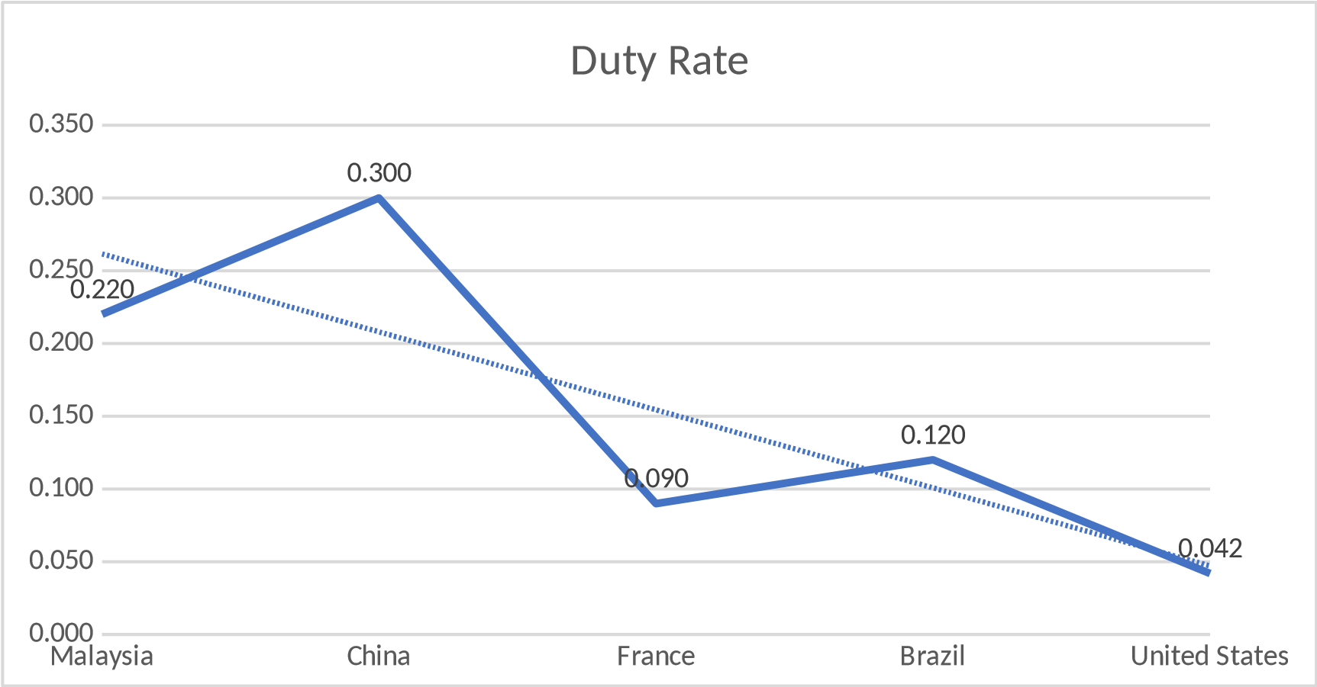
Duty Rate
The graph above illustrates the duty rate the corporation must pay other nations for products manufactured in the United States.
If a corporation establishes a plant in Spain, it is exempt from paying duty rates while selling items to customers in France.
If a corporation establishes a plant in Malaysia, it is exempt from paying duty rates while selling items to Malaysian customers.

Slide 9
Fixed Cost
The fixed cost is also a crucial factor influencing the management's decision to create the manufacturing unit.
The user's text is a symbol. The graph and table below illustrate the fixed cost associated with each plant for production quantities of 600,000 and 1,200,000 units.
Plant | Capacity | Fixed cost
Mobile | 600000 | 1276000
Charleston | 600000 | 1082000
Malaysia | 600000 | 1057000
Australia | 600000 | 1037000
Spain | 600000 | 994000
India | 600000 | 960000
Paris | 600000 | 875000
S Africa | 600000 | 801000
Austin | 600000 | 725000
Plant | Capacity | Fixed cost
Charleston | 1200000 | 1300000
Mobile | 1200000 | 1276000
Australia | 1200000 | 1256000
Austin | 1200000 | 1245000
Spain | 1200000 | 1213000
India | 1200000 | 1179000
Malaysia | 1200000 | 1178000
S Africa | 200000 | 1050000
Paris | 1200000 | 977000

Slide 10
Variable Cost, Freight and Warehouse Costs
Variable cost
Thirdly, the average variable cost of each product at the Austin factory is $1.52, the Australia plant is $0.85, the Charleston plant is $1.65, the India plant is $0.84, the Malaysia plant is $0.90, the Mobile plant is $1.38, the Paris plant is $1.56, the South Africa plant is $0.86, and the Spain plant is $1.77.
Freight and warehouse Costs
Fourthly, the Freight & Warehousing Costs (per unit) at the Austin plant amount to $0.30; at the Australia plant they amount to $0.60; at the Charleston plant, they amount to $0.27; at the India plant, they amount to $0.48, at the Malaysia plant they amount to $0.38, at the Mobile plant they amount to $0.27, at the Paris plant they amount to $0.32, at the South Africa plant they amount to $0.63, and at the Spain plant they amount to $0.41.

Slide 11
The Best Place And Capacity
Why Charleston Is The Best Place
Capacity of The New Plant
The Freight and warehousing Costs at the Charleston factory are lower than those of other factories.
The fixed expenses for the Charleston facility are relatively high but nearly equivalent to those of the other facilities.
The variable costs at the Charleston factory are elevated, but the company's management is knowledgeable about the regulations and processes in the United States.
This location is the optimal choice for establishing the plant.
By establishing the plant in Charleston, the corporation can circumvent the duty rate while selling products to clients in the United States.
Next, the products will be exported to different nations for a cheap duty charge of 0.042.
The local market has a significantly higher demand than international countries, making it the optimal choice.
The projected annual production capacity of the new Charleston factory is expected to be roughly 1,200,000 units.
Next, the management must arrange to transport the products from the Charleston facility to international destinations such as France, China, Malaysia, and Brazil.

Slide 12
References.
Baxter, K. (n.d.). Why rising freight and shipping costs affect consumer prices. https://blog.intekfreight-logistics.com/freight-shipping-costs-affect-consumer-prices
Camm, J. D., Cochran, J. J., Fry, M. J., & Ohlmann, J. W. (2021). Business Analytics Descriptive, Predictive Prescriptive. Brazil: Cengage Learning. Business Analytics
Design Spark. (n.d.). Nine uses of fiber optic cables. Retrieved from 9 uses of fiber optic cables
Hyatt, J. (2019). Meter-Scale Optical Systems (Doctoral dissertation, The University of Arizona). Meter-Scale Optical Systems
Lim, S. (2020, December 18). A glimpse of the future for fiber optics. Retrieved from A glimpse of the future for fiber optics.
Prologis. (n.d.). What Are the Best Ways to Reduce Warehouse Costs? What Are the Best Ways to Reduce Warehouse Costs?
Ratnasih, C., & Sulbahri, R. A. (2022). Full costing method model and variable costing method against cement price determination (Case in Indonesia). European Journal of Business and Management Research, 7(2), 284-288. Full costing method model and variable costing method against cement price determination
What is business forecasting? Why it matters. (n.d.). What is business forecasting? Why it matters.

